Slide 1
Firearm Registration correlated to state crime and social statistics Data
Dream Team
Team Leader: Gene
Mike
Ted
Enerel
GW_Data Analytics BootCamp
July, 2019

Slide 2
Facts:
Gun violence in the United States results in thousands of deaths and injuries each year.
The US currently has the most gun-related murders per 100,000 people in the developed world, at a little over 3 gun murders per 100,000 people (CDC, 2015).

Slide 9
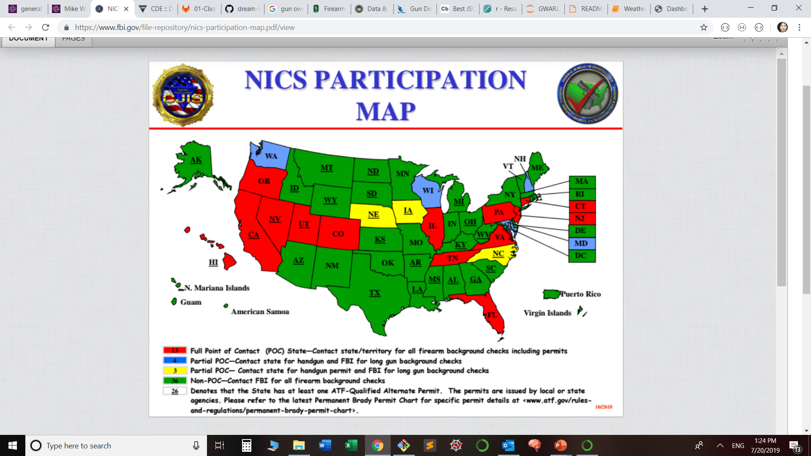

Slide 10
References:
CDC (2015). Injury mortality reports 1999 and onwards (USA). In Web-based Injury Statistics Query and Reporting System / CDC WISQARS. Atlanta: National Center for Injury Prevention and Control, Centers for Disease Control and Prevention / CDC.

